Slide 1

ORGANIZATIONAL BEHAVIOR

Slide 2
After studying chapter six and listening to my lecture, you should be able to:
Outline the motivation process.
Describe Maslow’s need hierarchy.
Contrast Theory X and Theory Y.
Differentiate motivators from hygiene factors.
List the characteristics that high achievers prefer in a job.
Summarize the types of goals that increase performance.
L E A R N I N G O B J E C T I V E S

Slide 3
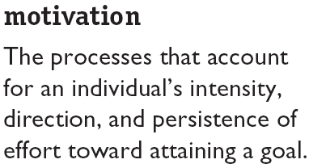
Defining Motivation
Key Elements
Intensity: how hard a person tries
Direction: toward beneficial goal
Persistence: how long a person tries

Slide 4
Going “Beyond the Fringe” in Benefits: Especially Creative Reward Practices
Company
Apple Computer
Publix Super Markets
Advanta Corporation
Westin Hotels
Worthington Industries
Reader’s Digest
Pitney Bowes
Steelcase
Delta Airlines
Reward
Stock purchase options
Partial ownership in the company
Opportunity to help train new employees
Free meals while on the job
Haircuts for $2 while at work
Fridays off during the month of May
Courses in real estate, golf, painting, photography,
and cake decorating
Access to camping facilities and equipment
Free airline travel for employees and spouses
SAS Company???
Notes:
6

Slide 5
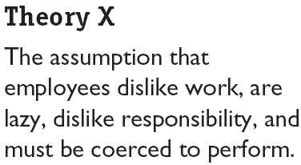

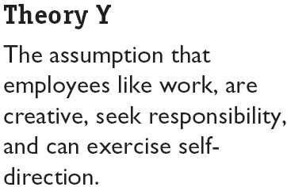

Theory X and Theory Y (Douglas McGregor)

Slide 6
Need Hierarchy Theory
Higher-order
needs
Self-
actualization
needs
Esteem needs
Social needs
Safety needs
Physiological needs
Lower-order
needs
Notes:
3

Slide 7
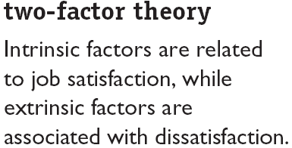

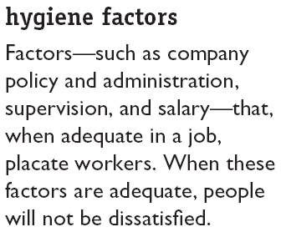
Two-Factor Theory (Frederick Herzberg)

Slide 8
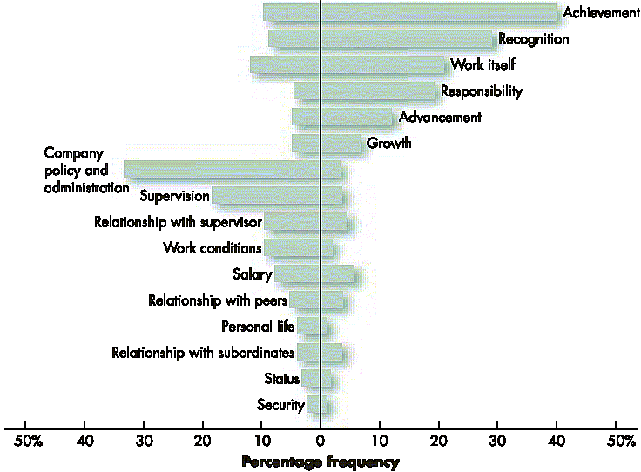
Comparison of Satisfiers and Dissatisfiers
Factors characterizing events on the job that led to extreme job dissatisfaction
Factors characterizing events on the job that led to extreme job satisfaction

Slide 9
Overview of Expectancy Theory
Effort
Performance
Reward
Expectancy
Instrumentality
Valence of
reward
X
X
MOTIVATION
Abilities
and traits
Role perceptions
and opportunities
JOB
PERFORMANCE
Notes:
5

Slide 10
Equity Theory: A Summary and Example
INEQUITABLE RELATIONSHIP
Andy is
overpaid
compared to Bill
Bill is
underpaid
compared to Andy
Bill’s outcomes
($25,000/year)
Bill’s inputs
(40 hours/week)
Andy’s outcomes
($30,000/year)
Andy’s inputs
(40 hour/week)
Andy feels guilty
Bill feels angry
EQUITABLE RELATIONSHIP
Andy is equitably paid
compared to Bill
Bill is equitably paid
compared to Andy
Andy’s outcomes
($30,000/year)
Andy’s inputs
(40 hour/week)
Bill’s outcomes
($30,000/year)
Bill’s inputs
(40 hours/week)
Andy feels
satisfied
Bill feels
satisfied
Notes:
4

Slide 11
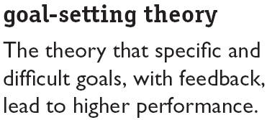

Goal-Setting Theory (Edwin Locke)

Slide 12
Goal Setting: Some Impressive Effects
100
Goal
level
94
90
80
Performance at the goal level
was sustained seven years after
the goal was first set
70
Percentage of Maximum Weight
Carried on Each Trip
60
There was a dramatic
improvement in per-
formance after a goal
was set
50
1
2
3
4
5
6
7
8
9
10
11
12
Seven
Years Later
Before goal
After Goal
Four-Week Periods
Notes:
7

Slide 13
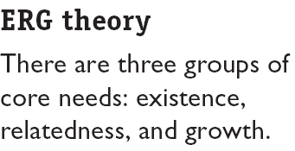
ERG Theory (Clayton Alderfer)
Concepts:
More than one need can be operative at the same time.
If a higher-level need cannot be fulfilled, the desire to satisfy a lower-level need increases.
Core Needs
Existence: provision of basic material requirements.
Relatedness: desire for relationships.
Growth: desire for personal development.

Slide 14
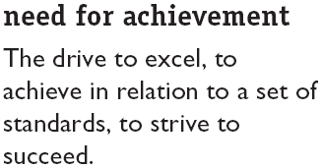
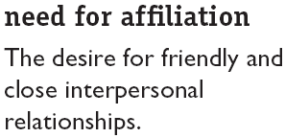
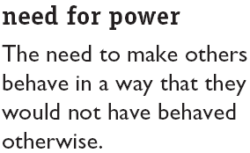
David McClelland’s Theory of Needs
nPow
nAch
nAff

Slide 15
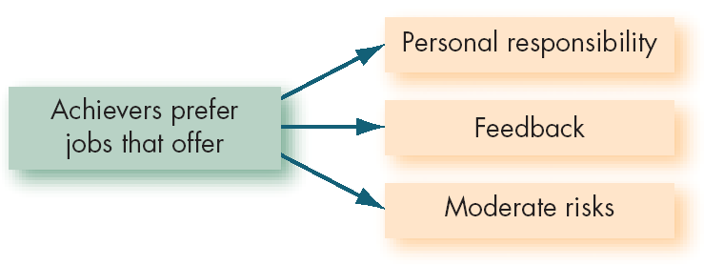
Matching Achievers and Jobs

Slide 16
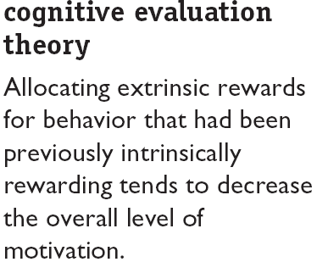

Cognitive Evaluation Theory

Slide 17
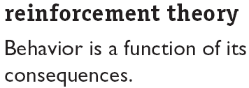
Reinforcement Theory
Concepts:
Behavior is environmentally caused.
Behavior can be modified (reinforced) by providing (controlling) consequences.
Reinforced behavior tends to be repeated.

Slide 18

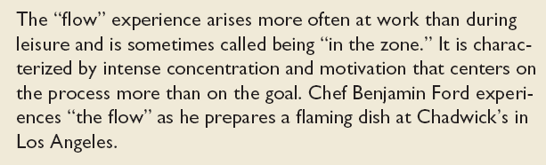
Flow and Intrinsic Motivation Theory

Slide 19
Ken Thomas’s Model of Intrinsic Motivation
Employees are intrinsically motivated when rewards an employee gets from work result from:
  Choice– the ability to freely self-select and perform task activities.
  Competence– the sense of accomplishment from skillfully performing chosen tasks or activities.
  Meaningfulness– pursuing a task that matters in the larger scheme of things.
  Progress– the feeling of significant advancement in achieving the task’s purpose.

Slide 20
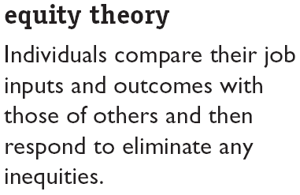
Equity Theory
Referent Comparisons:
Self-inside
Self-outside
Other-inside
Other-outside

Slide 21
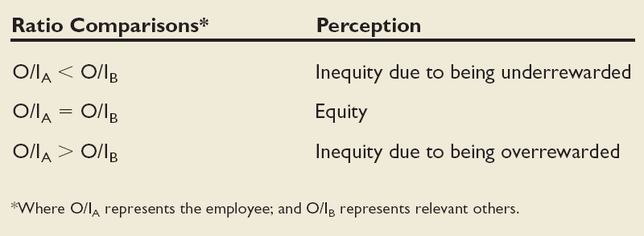
Equity Theory (cont’d)
6-7
E X H I B I T

Slide 22
Equity Theory (cont’d)
Choices for dealing with inequity:
Change inputs (slack off)
Change outcomes (increase output)
Distort/change perceptions of self
Distort/change perceptions of others
Choose a different referent person
Leave the field (quit the job)

Slide 23
Equity Theory (cont’d)
Propositions relating to inequitable pay:
Overrewarded employees produce more than equitably rewarded employees.
Overrewarded employees produce less, but do higher quality piece work.
Underrewarded hourly employees produce lower quality work.
Underrewarded employees produce larger quantities of lower-quality piece work than equitably rewarded employees

Slide 24
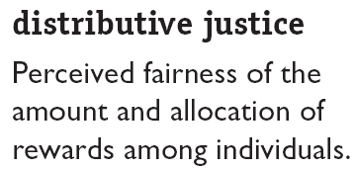

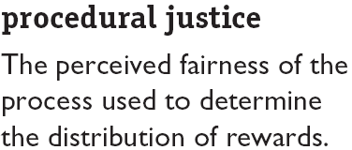
Equity Theory (cont’d)

Slide 25
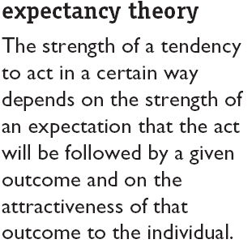
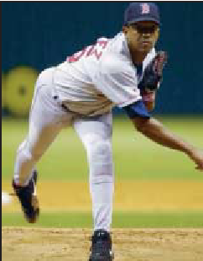
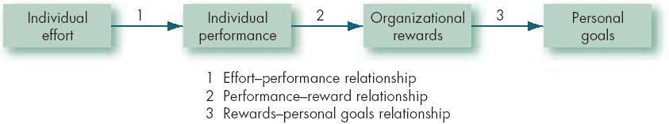
Expectancy Theory
6-8
E X H I B I T

Slide 26
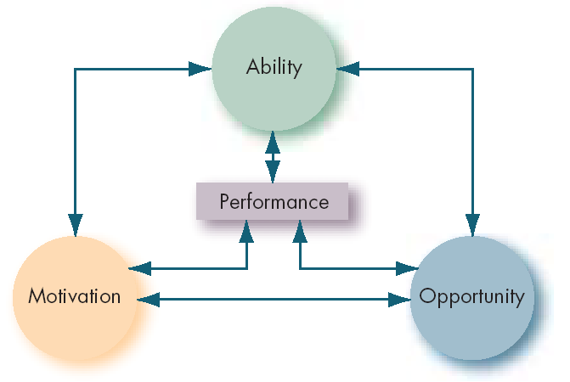

Performance Dimensions
6-9
E X H I B I T

Slide 27
Integrating Contemporary Theories of Motivation
E X H I B I T

